Slide 1
Weekly Progress
Sem 2 Week 2&3

Slide 2
Emotion generator EmotalkingFace
The motivation is to decouple the speech and emotion conditions. This allows us to manipulate emotions during the generation of face videos.
One discriminator to distinguish between emotions expressed in videos, and another discriminator to distinguish between the real and generated video frames.
The generator network contains the following sub-networks: speech, image, noise, and emotion encoders, and a video decoder
=>> Trying to train and get for emotion model

Slide 3
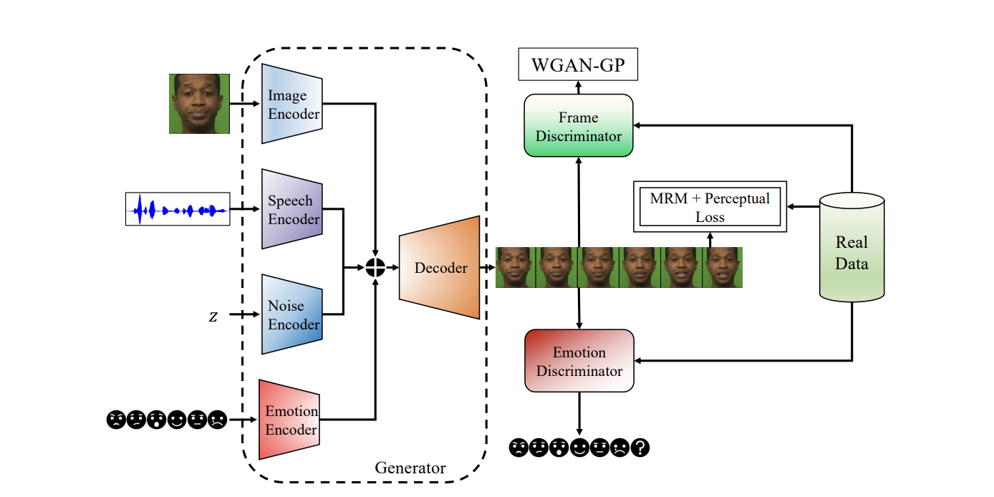
EmotalkingFace for Emotion Encoder
The emotion label is first encoded as a one-hot vector and fed into the emotion encoder. The emotion encoder uses a two-layer fully connected (FC) neural network to project the one-hot vector to an emotion embedding. This embedding is replicated for each time step. We use a LeakyReLU activation with a 0.2 slope after every FC layer

Slide 4
Pose implementation
Was planning to do head pose first then add lip sync
Changed lip sync method since video-retalking make the mouth neutral first (not suitable for our emotion talking face generation)
Initial plan
Head pose
Lip sync
Image

Slide 5


Problem with head pose + lip sync
This is team 64 emotional talking face generation project
+
Input video
Output video

Slide 6


Problem with head pose + lip sync
This is team 64 emotional talking face generation project
+
Input video
Output video

